Slide 1


AI-Driven Climate Change Model
A Data-Driven Approach using Multi-model Regression System
and Feature Importance Analysis
Presented by: Sai kumar Gaddam
July 2025

Slide 2

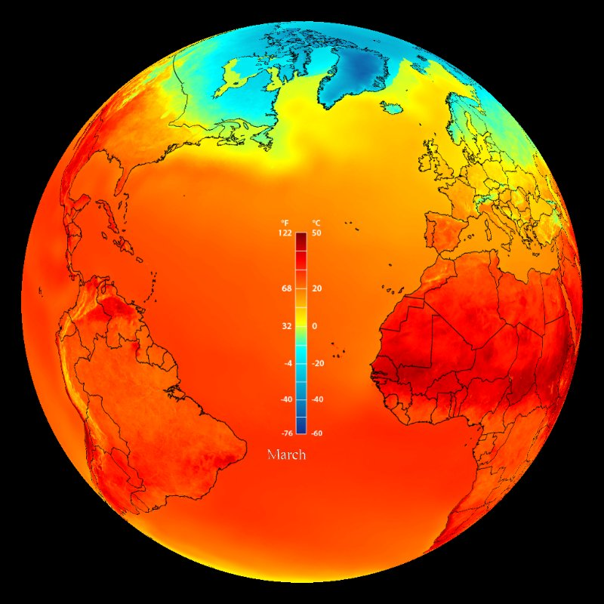




Climate-Aware Temperature Prediction
A Data-Driven Approach using Multi-model Regression System and Feature Importance Analysis
Presented by: Saikumar
July 2025
Research Problem
Introduction
"Which environmental factors most significantly influence the rise in average temperature, and how accurately can we predict it using machine learning?"
Data Complexity
Global Climate Challenge
Climate data is inherently complex, nonlinear, and multi-variable, making direct analysis challenging.
Climate change is causing extreme weather, sea level rise, and rising global temperatures, impacting communities worldwide.
Traditional Limitations
Need for Accurate Prediction
Manual temperature prediction methods are inefficient and often prone to error, struggling with vast datasets.
Understanding the drivers of temperature change is critical for informed policy-making and strategic planning.
Tooling Gap
Leveraging Machine Learning
There is currently no universal, data-driven tool for accurate temperature forecasting directly from environmental inputs.
Identifies hidden patterns in complex climate datasets.
Enables more precise forecasting of future climate trends.
Model Opacity
Our Project Contribution
Many existing climate prediction models suffer from a lack of explainability, limiting trust and actionable insights.
We use real-world climate data and ML to predict temperature and uncover key influencing factors.

Slide 3










Research Problem
"Which environmental factors most significantly influence the rise in average temperature, and how accurately can we predict it using machine learning?"
Data Complexity
Climate data is inherently complex, nonlinear, and multi-variable, making direct analysis challenging.
Traditional Limitations
Manual temperature prediction methods are inefficient and often prone to error, struggling with vast datasets.
Tooling Gap
There is currently no universal, data-driven tool for accurate temperature forecasting directly from environmental inputs.
Model Opacity
Many existing climate prediction models suffer from a lack of explainability, limiting trust and actionable insights.
Aim & Objectives
Aim
To develop a machine learning model for accurate temperature prediction based on climate indicators and identify the most influential environmental features contributing to global temperature change.
Our key objectives are:
Data Exploration & Loading
Data Preprocessing
Feature Selection
Model Training
Load and explore a comprehensive, real-world climate dataset to understand its structure and content.
Preprocess data thoroughly, including effective handling of missing values and outliers.
Select the most relevant environmental features that significantly impact global temperature fluctuations.
Train a robust predictive model using theMulti-model Regression System regression algorithm for accurate temperature forecasting.
Feature Importance Analysis
Actionable Insights
Analyze and visualize the key feature importance for better interpretability and understanding of the model's predictions.
Generate actionable insights from the model's findings to understand and address climate impact patterns effectively.

Slide 4

Aim & Objectives
Aim
Dataset Overview
To accurately predict temperature, we utilized a comprehensive dataset:
To develop a machine learning model for accurate temperature prediction based on climate indicators and identify the most influential environmental features contributing to global temperature change.
Scope
Source & Type
Records: 1,000+
Kaggle: Climate Change Dataset
Features: 8 key indicators + target
Type: Time-series & cross-sectional environmental indicators
Our key objectives are:
Time Range: 1960–2020
Key Features for Prediction
Sea Level Rise
Data Exploration & Loading
Data Preprocessing
Feature Selection
Model Training
Millimeters
CO₂ Emissions
Load and explore a comprehensive, real-world climate dataset to understand its structure and content.
Preprocess data thoroughly, including effective handling of missing values and outliers.
Select the most relevant environmental features that significantly impact global temperature fluctuations.
Train a robust predictive model using the Multi-model Regression System algorithm for accurate temperature forecasting.
Tons/Capita
Population
Rainfall
Global count
Millimeters
Extreme Weather
Renewable Energy
Event frequency
Percentage
Forest Area
Feature Importance Analysis
Actionable Insights
Percentage
Analyze and visualize the key feature importance for better interpretability and understanding of the model's predictions.
Generate actionable insights from the model's findings to understand and address climate impact patterns effectively.

Slide 5

Dataset Overview
To accurately predict temperature, we utilized a comprehensive dataset:
Source & Type
Scope
Kaggle: Climate Change Dataset
Records: 1,000+
Type: Time-series & cross-sectional environmental indicators
Features: 7 key indicators + target
Time Range: 1960–2020
Key Features for Prediction
CO₂ Emissions
Sea Level Rise
Tons/Capita
Millimeters
Rainfall
Population
Millimeters
Global count
Renewable Energy
Extreme Weather
Percentage
Event frequency
Forest Area
Percentage
Data Preprocessing
Transforming raw climate data into a clean, model-ready format.
Raw Data
Missing Values
Initial dataset from various sources.
Handled nulls using mean imputation.
Feature Scaling
Clean Dataset
Standardized ranges with StandardScaler.
Ready for robust model training.
Missing Value Check:
Missing values after imputation:
CO2 Emissions (Tons/Capita) 0
Sea Level Rise (mm) 0
Rainfall (mm) 0
Population 0
Renewable Energy (%) 0
Extreme Weather Events 0
Forest Area (%) 0
dtype: int64
Our meticulous preprocessing steps ensure the dataset is optimized for machine learning algorithms, providing a solid foundation for accurate temperature prediction.

Slide 6
















Feature Engineering & Selection
Data Preprocessing
Understanding which inputs drive temperature change.
Transforming raw climate data into a clean, model-ready format.
Target Variable
Raw Data
Missing Values
CO₂ Emissions
Avg Temperature (°C)The primary focus of our prediction model.
Initial dataset from various sources.
Handled nulls using mean imputation.
Tons/Capita
Feature Scaling
Clean Dataset
Forest Area
Standardized ranges with StandardScaler.
Ready for robust model training.
Sea Level Rise
Percentage
Millimeters
Missing Value Check:
Extreme Weather
Missing values after imputation:
CO2 Emissions (Tons/Capita) 0
Sea Level Rise (mm) 0
Rainfall (mm) 0
Population 0
Renewable Energy (%) 0
Extreme Weather Events 0
Forest Area (%) 0
dtype: int64
Rainfall
CO2 Emissions (Tons/Capita) 0
Sea Level Rise (mm) 0
Rainfall (mm) 0
Population 0
Renewable Energy (%) 0
Extreme Weather Events 0
Forest Area (%) 0
dtype: int64
Event Frequency
Millimeters
Renewable Energy
Population
Percentage
Global Count
Our meticulous preprocessing steps ensure the dataset is optimized for machine learning algorithms, providing a solid foundation for accurate temperature prediction.
1
Why Manual Selection?
Our features were carefully selected based on climate science relevance and domain knowledge. This approach helped us avoid redundant or weakly correlated features, ensuring a robust and interpretable model.

Slide 7








Feature Engineering & Selection
System Architecture: How Everything Connects
Understanding which inputs drive temperature change.
Target Variable
CO₂ Emissions
Avg Temperature (°C)The primary focus of our prediction model.
Tons/Capita
Our project follows a streamlined pipeline, transforming raw climate data into actionable insights for temperature prediction.
1
1
Forest Area
Sea Level Rise
Feature Importance
Feature Selection
Percentage
Millimeters
Raw Dataset
7 key environmental variables
Understanding key drivers
Extreme Weather
Rainfall
CSV from Kaggle
Event Frequency
Millimeters
Renewable Energy
Population
Percentage
Global Count
Data Preprocessing
Model Training
Temperature Prediction
XGBoost Regressor
Why Manual Selection?
Handling missing values, feature scaling
Forecasting average temperature
Our features were carefully selected based on climate science relevance and domain knowledge. This approach helped us avoid redundant or weakly correlated features, ensuring a robust and interpretable model.

Slide 8





Model Implementation – Building the multi-model regression system
Core Model Code Snippet:
X, y = df.iloc[:, 1:-1].fillna(df.mean()), df.iloc[:, -1]
from sklearn.model_selection import train_test_split; from sklearn.ensemble import RandomForestRegressor as RF
from sklearn.preprocessing import StandardScaler; from sklearn.metrics import mean_squared_error as mse, mean_absolute_error as mae
from tensorflow.keras.models import Sequential, Model; from tensorflow.keras.layers import *
import numpy as np
X = StandardScaler().fit_transform(X); Xt, Xv, yt, yv = train_test_split(X, y, test_size=0.2)
Xt3d, Xv3d = Xt[:,None,:], Xv[:,None,:]
rf = RF().fit(Xt, yt); lstm = Sequential([LSTM(64, input_shape=(1,X.shape[1])), Dropout(0.2), Dense(1)])
lstm.compile('adam','mse'); lstm.fit(Xt3d, yt, epochs=20, verbose=0)
inp = Input((1,X.shape[1])); x = MultiHeadAttention(2,4)(inp,inp); x = LayerNormalization()(x)
x = Dense(64,'relu')(x); x = Dropout(0.2)(x); out = Dense(1)(x)
trans = Model(inp, out); trans.compile('adam','mse'); trans.fit(Xt3d, yt, epochs=20, verbose=0)
for n, p in zip(['RF','LSTM','Trans'], [rf.predict(Xv), lstm.predict(Xv3d).ravel(), trans.predict(Xv3d).ravel()]):
print(f'{n} RMSE:{np.sqrt(mse(yv,p)):.2f} MAE:{mae(yv,p):.2f}')
System Architecture: How Everything Connects
Our project follows a streamlined pipeline, transforming raw climate data into actionable insights for temperature prediction.
Evaluation & Comparison
Feature Importance
Raw Dataset
Linear Regressor
Understanding key drivers
CSV from Kaggle
Data Preprocessing
Model Training
Temperature Prediction
Random Forest
LSTM Neural Network
Transformer Model (DL)
Handling missing values, feature scaling
Forecasting average temperature
Multi-model Regression System
Implementation Workflow
Training & Interpretability
Our chosen model for accurate temperature prediction.
Input: Preprocessed & scaled climate features.
Model trained on the full 7-variable feature set.
Multi-Model Comparison.
Output: Predicted average temperature (°C).
Achieves fast training and high interpretability.
Feature-Rich & Scalable.
Robust Evaluation.

Slide 9






Feature Importance – What Drives Temperature Change?
Model Implementation – Building the multi-model regression system
Core Model Code Snippet:
Understanding Our Model's Focus
After training, our Multi-model Regression System
provides insights into which features most influenced its temperature predictions.
X, y = df.iloc[:, 1:-1].fillna(df.mean()), df.iloc[:, -1]
from sklearn.model_selection import train_test_split; from sklearn.ensemble import RandomForestRegressor as RF
from sklearn.preprocessing import StandardScaler; from sklearn.metrics import mean_squared_error as mse, mean_absolute_error as mae
from tensorflow.keras.models import Sequential, Model; from tensorflow.keras.layers import *
import numpy as np
X = StandardScaler().fit_transform(X); Xt, Xv, yt, yv = train_test_split(X, y, test_size=0.2)
Xt3d, Xv3d = Xt[:,None,:], Xv[:,None,:]
rf = RF().fit(Xt, yt); lstm = Sequential([LSTM(64, input_shape=(1,X.shape[1])), Dropout(0.2), Dense(1)])
lstm.compile('adam','mse'); lstm.fit(Xt3d, yt, epochs=20, verbose=0)
inp = Input((1,X.shape[1])); x = MultiHeadAttention(2,4)(inp,inp); x = LayerNormalization()(x)
x = Dense(64,'relu')(x); x = Dropout(0.2)(x); out = Dense(1)(x)
trans = Model(inp, out); trans.compile('adam','mse'); trans.fit(Xt3d, yt, epochs=20, verbose=0)
for n, p in zip(['RF','LSTM','Trans'], [rf.predict(Xv), lstm.predict(Xv3d).ravel(), trans.predict(Xv3d).ravel()]):
print(f'{n} RMSE:{np.sqrt(mse(yv,p)):.2f} MAE:{mae(yv,p):.2f}')
CO₂ Emissions
Tons/Capita: The most significant driver of temperature change.
Forest Area
Percentage: Key for carbon absorption and climate regulation.
Sea Level Rise
Millimeters: Indicative of broader climate shifts.
Multi-model Regression System
Implementation Workflow
Training & Interpretability
Understanding which variables most affect temperature helps inform climate policy and risk prediction.
Our chosen model for accurate temperature prediction.
Input: Preprocessed & scaled climate features.
Model trained on the full 7-variable feature set.
Multi-Model Comparison.
Output: Predicted average temperature (°C).
Achieves fast training and high interpretability.
Feature-Rich & Scalable.
Robust Evaluation.

Slide 10

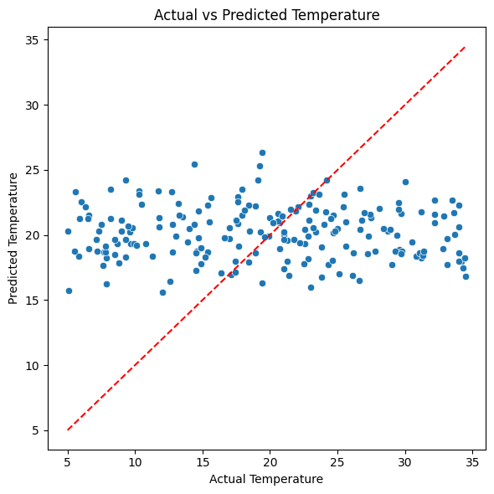
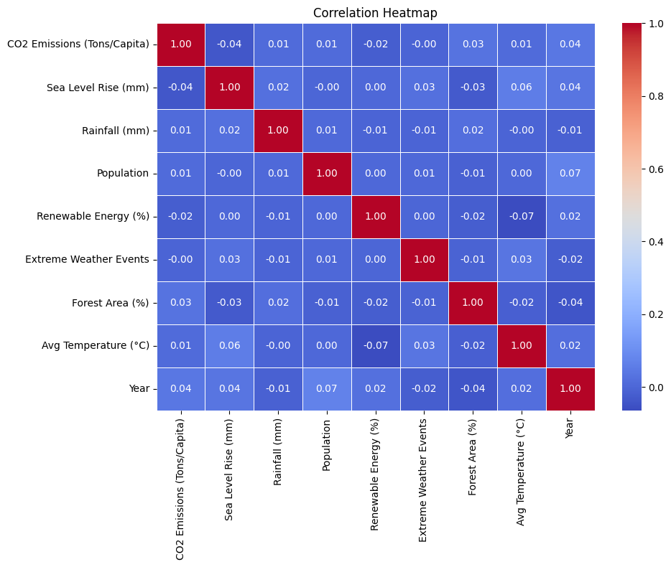
Additional Visualizations – Understanding the Climate Data
Dive deeper into our dataset with visual analyses revealing feature distributions, correlations, and underlying climate patterns.
Feature Importance – What Drives Temperature Change?
Understanding Our Model's Focus
Actual vs Predicted Temperature
After training, our Multi-model Regression System
provides insights into which features most influenced its temperature predictions.
Feature Correlation Heatmap
CO₂ Emissions
Tons/Capita: The most significant driver of temperature change.
Forest Area
Percentage: Key for carbon absorption and climate regulation.
Sea Level Rise
Millimeters: Indicative of broader climate shifts.
Understanding which variables most affect temperature helps inform climate policy and risk prediction.
Key Insights from Visual Analysis
Stable Predicted Temperature Range
No Multicollinearity in Features
Clean and Balanced Dataset
In the Actual vs Predicted Temperature plot, most predictions lie within a narrow and consistent range (~18–22°C).
From the Correlation Heatmap, no pair of features shows a very high correlation (close to ±1)
The heatmap shows a balanced and evenly distributed set of features with no dominant variable overpowering others.

Slide 11




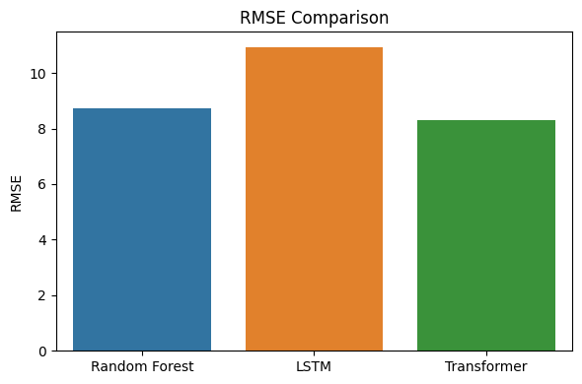


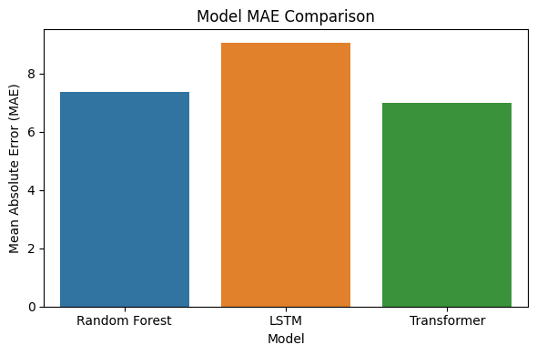

Results Summary – What Did We Learn from the Model?
Additional Visualizations – Understanding the Climate Data
Objective
Results
Predict average temperature (°C) using environmental factors like CO₂ emissions, sea level rise, rainfall, population, etc., via multiple machine learning models.
Dive deeper into our dataset with visual analyses revealing feature distributions, correlations, and underlying climate patterns.
Actual vs Predicted Temperature
Feature Correlation Heatmap
Models Compared
Random Forest Regressor
LSTM (Long Short-Term Memory)
Transformer (Attention-Based Model)
Performance Metrics
Root Mean Squared Error (RMSE)
Mean Absolute Error (MAE)
Conclusion
Transformer provides the most reliable and consistent temperature predictions in this study.
Key Insights from Visual Analysis
Stable Predicted Temperature Range
No Multicollinearity in Features
Clean and Balanced Dataset
In the Actual vs Predicted Temperature plot, most predictions lie within a narrow and consistent range (~18–22°C).
From the Correlation Heatmap, no pair of features shows a very high correlation (close to ±1)
The heatmap shows a balanced and evenly distributed set of features with no dominant variable overpowering others.

Slide 12






Conclusion & Future Scope – Wrapping It All Up
Conclusion
Model Success
Deep Learning with Attention Proved Effective
Random Forest Still a Strong Baseline
Among Random Forest, LSTM, and Transformer, the Transformer model showed the lowest MAE and RMSE, making it the most accurate predictor for average temperature.
Attention mechanisms in the Transformer helped it better learn from complex climate features compared to traditional RNNs like LSTM.
Despite being a traditional model, Random Forest delivered competitive results, making it a reliable and interpretable alternative.
Results Summary – What Did We Learn from the Model?
Objective
Results
Predict average temperature (°C) using environmental factors like CO₂ emissions, sea level rise, rainfall, population, etc., via multiple machine learning models.
Models Compared
Random Forest Regressor
LSTM (Long Short-Term Memory)
Transformer (Attention-Based Model)
Performance Metrics
Root Mean Squared Error (RMSE)
Mean Absolute Error (MAE)
Conclusion
Transformer provides the most reliable and consistent temperature predictions in this study.
Future Scope
Temporal Feature Integration
Hybrid Model Development
Interactive Deployment
Integrate time series forecasting methods to predict year-wise temperature trends with greater accuracy and temporal context.
Incorporate satellite or remote sensing data to achieve higher granularity and broader spatial coverage for input features.
Develop a real-time, interactive dashboard using Streamlit or Flask, enabling public access and broader climate awareness.

Slide 13


Thank You!
Conclusion & Future Scope – Wrapping It All Up
Conclusion
Model Success
Deep Learning with Attention Proved Effective
Random Forest Still a Strong Baseline
Questions & Answers 💬
Among Random Forest, LSTM, and Transformer, the Transformer model showed the lowest MAE and RMSE, making it the most accurate predictor for average temperature.
Attention mechanisms in the Transformer helped it better learn from complex climate features compared to traditional RNNs like LSTM.
Despite being a traditional model, Random Forest delivered competitive results, making it a reliable and interpretable alternative.
Future Scope
👤 Presenter: Saikumar
Temporal Feature Integration
Hybrid Model Development
Interactive Deployment
Integrate time series forecasting methods to predict year-wise temperature trends with greater accuracy and temporal context.
Incorporate satellite or remote sensing data to achieve higher granularity and broader spatial coverage for input features.
Develop a real-time, interactive dashboard using Streamlit or Flask, enabling public access and broader climate awareness.
📧 Email: saikumar@email.com
🐙 GitHub: github.com/saikumar-ml
🏫 Institution: Our Research Institution

Slide 14

Thank You!
Questions & Answers 💬
👤 Presenter: Sai kumar Gaddam
📧 Email: saikumargaddam949@gmail.com
🐙 GitHub: https://github.com/saikumar-gaddam/Project-
🏫 Institution: Our Research Institution

